Slide 1
IUGONET plugin
for SPEDAS
Y. Tanaka¹, A. Shinbori², N. Umemura³, Y. Koyama⁴, S. Abe⁵, M. Yagi⁶, S. UeNo⁷, and IUGONET project team
¹National Institute of Polar Research,
²Research Institute of Sustainable Humanosphere, Kyoto University,
³Solar-Terrestrial Environment Laboratory, Nagoya University,
⁴Transdisciplinary Research Integration Center, Research Organization of Information and Systems,
⁵International Center for Space Weather Science and Education, Kyushu University,
⁶Planetary Plasma and Atmospheric Research Center, Tohoku University,
⁷Kwasan and Hida Observatories, Kyoto University.

Slide 2
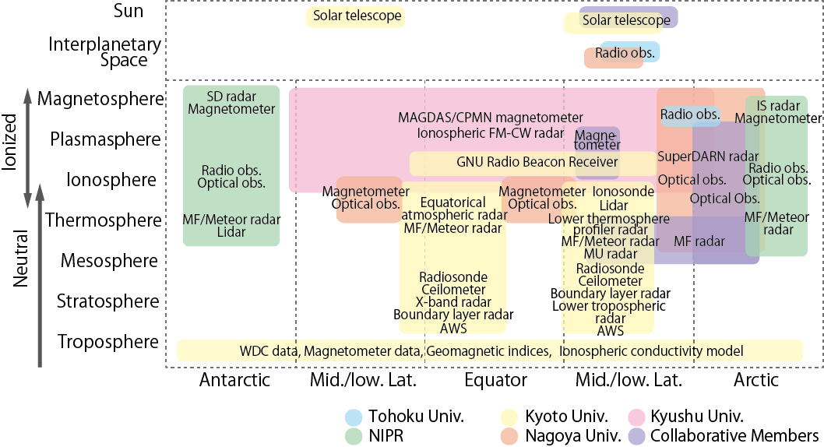
IUGONET project
The Inter-university Upper atmosphere Global Observation NETwork, IUGONET, is an inter-university collaborative project that comprises five Japanese institutes/universities (Tohoku Univ., Nagoya Univ., Kyoto Univ., Kyushu Univ., and NIPR).
This project’s aim is to develop metadata database and data analysis software that facilitates the distribution of our data in the STP community and thereby promotes the interdisciplinary studies across multiple areas of the upper atmosphere.

Slide 3
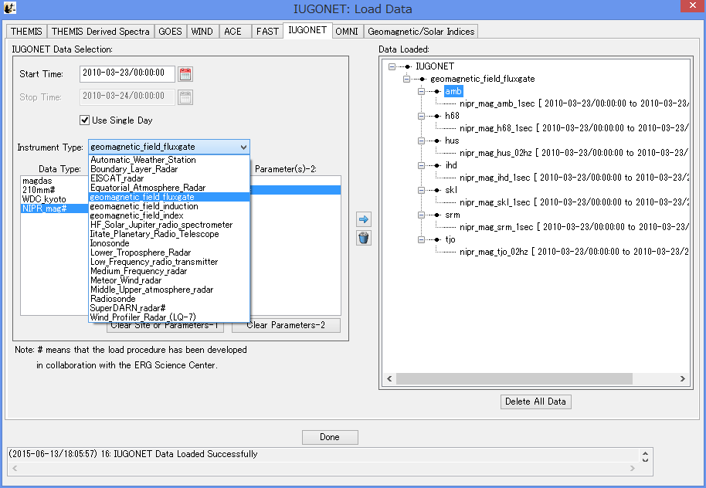
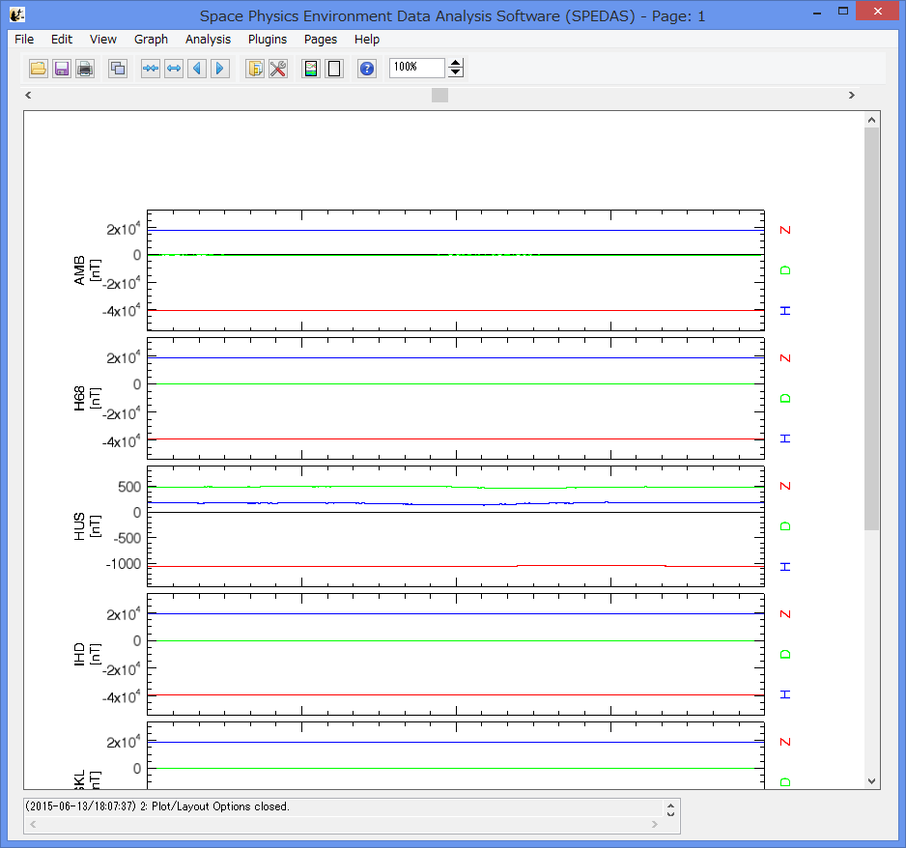
IUGONET plug-in (UDAS) for TDAS
The iugonet plugin (called UDAS) includes many load procedures for the ground-based observational data.
GUI window of SPEDAS
Various types of ground-based observational data provided by the IUGONET members are available on the SPEDAS.

Slide 4
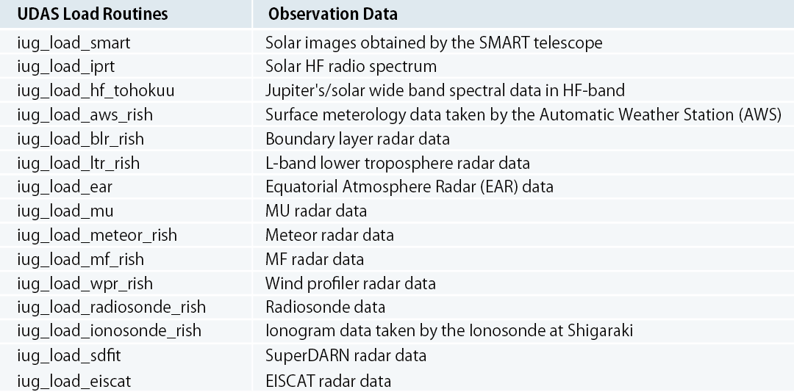
Load procedures in UDAS (1)
Sun,
planets
Troposphere,
Stratosphere,
Mesosphere, etc.
Ionosphere
The iugonet plugin includes 29 load procedures for data obtained by solar telescope, atmosphere and ionosphere radars, imagers, magnetometers, and so on.

Slide 5
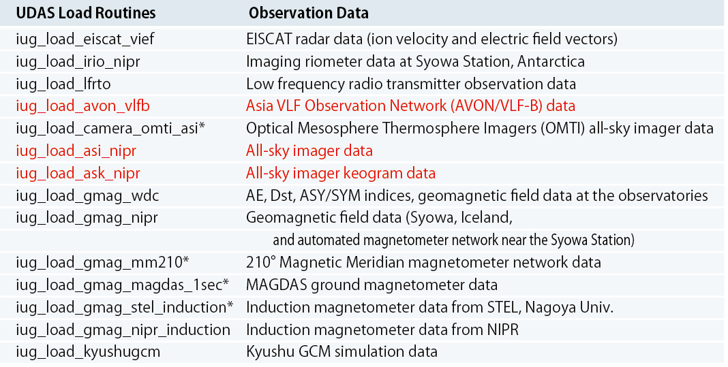
Load procedures in UDAS (2)
Ionosphere
Imager
data
Magnetometer
data
Simulation
Red: New procedures.
They will be added to SPEDAS v2.
* : Aliases of the load procedures included in the ERG plugin tool.

Slide 6
The latest version of UDAS
IUGONET website:
http://www.iugonet.org/
The latest version of the iugonet plugin can be downloaded on our website.

Slide 7
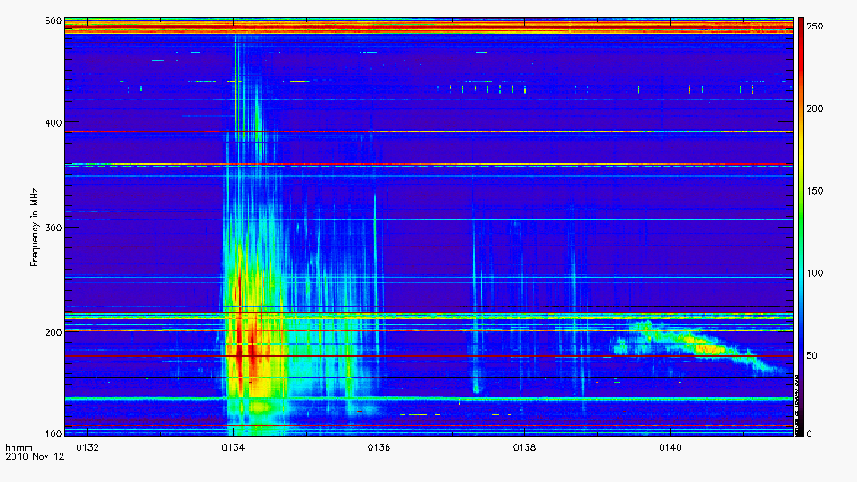
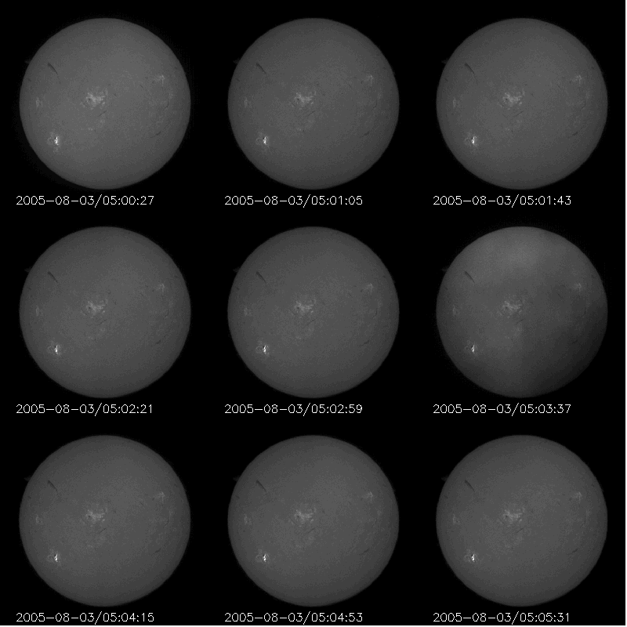
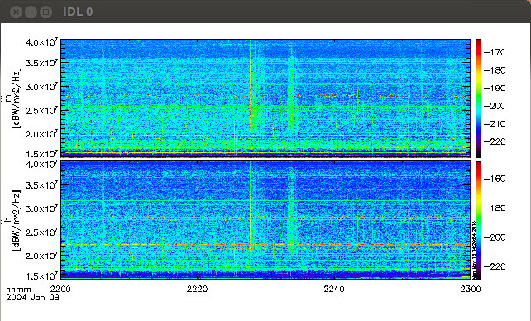
Examples of the visualization of the IUGONET data
Solar VHF Radio Spectrum data by IPRT
Solar images taken by the SMART telescope
Type-III
Type-II
Solar wide band spectral data in HF-band

Slide 8
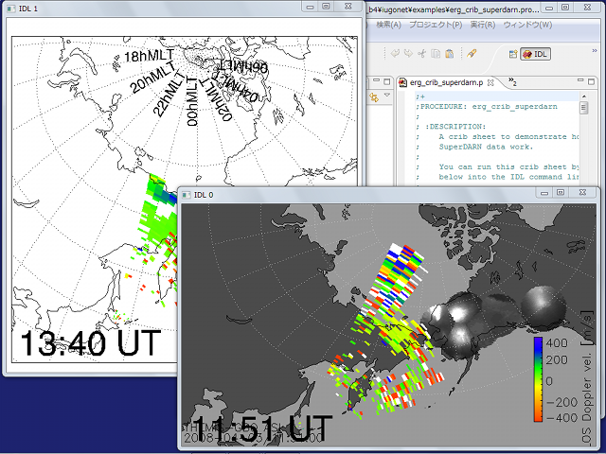
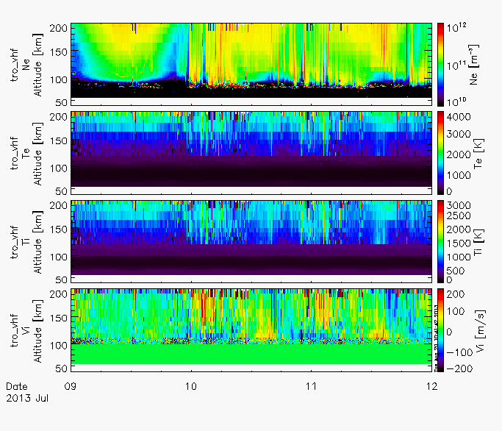
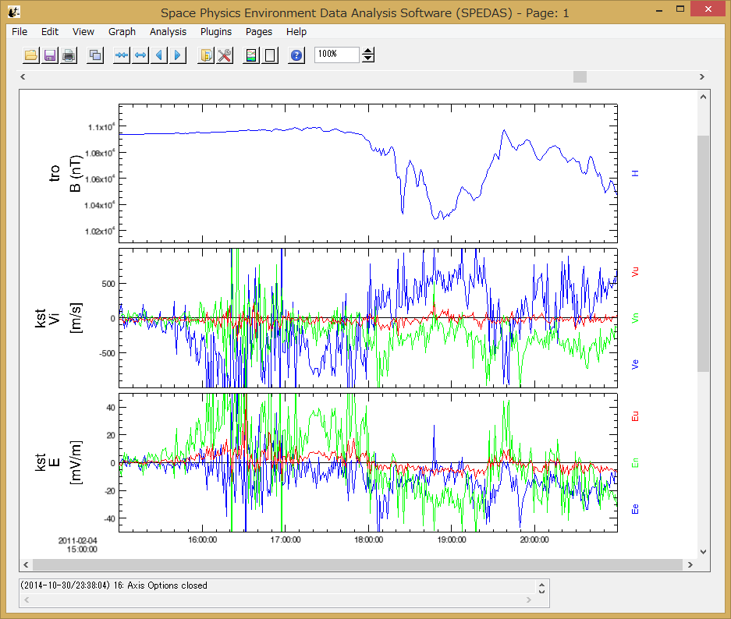
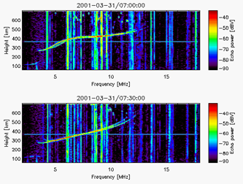
SuperDARN radar
EISCAT radar
Ionosonde
E and Vi vectors from EISCAT

Slide 9
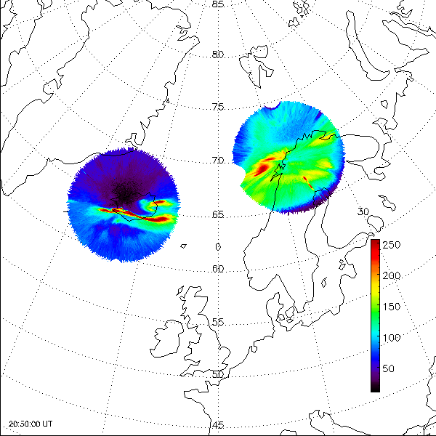
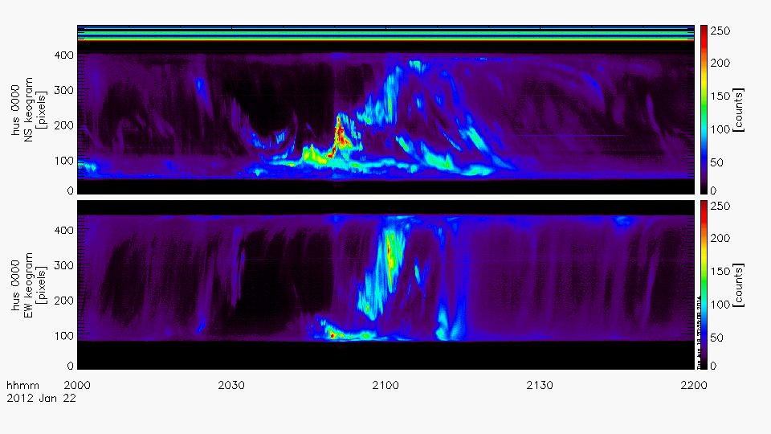
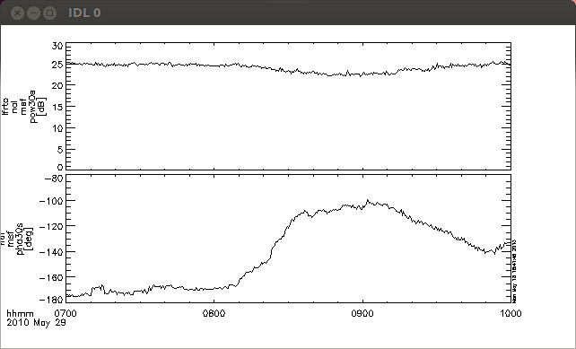
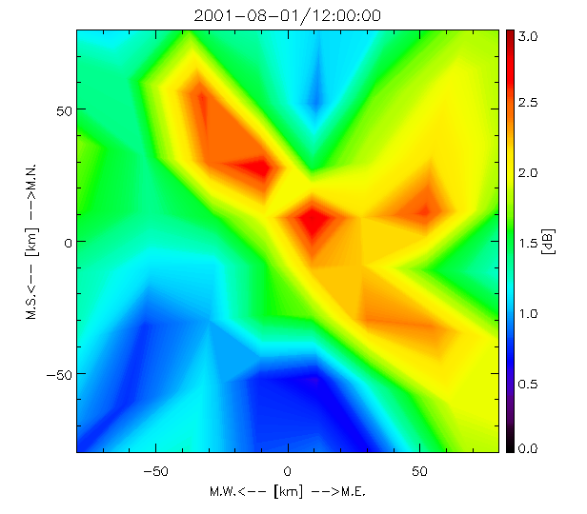
All-Sky Imager Keogram
All-Sky Imagers
Low Frequency Radio Transmitter
Imaging Riometer

Slide 10
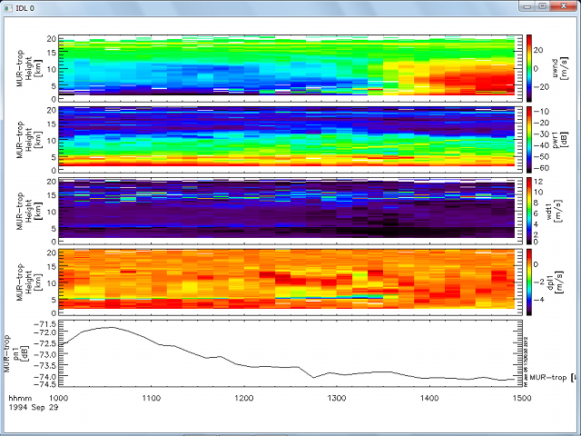
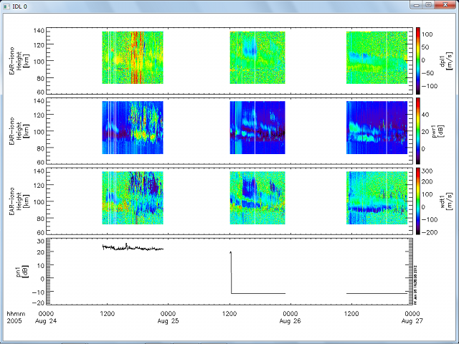
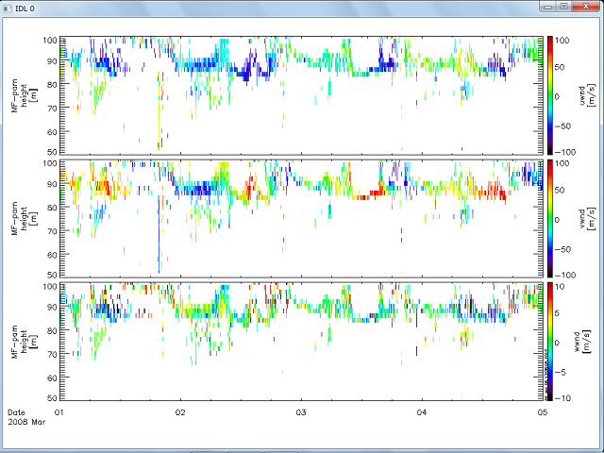
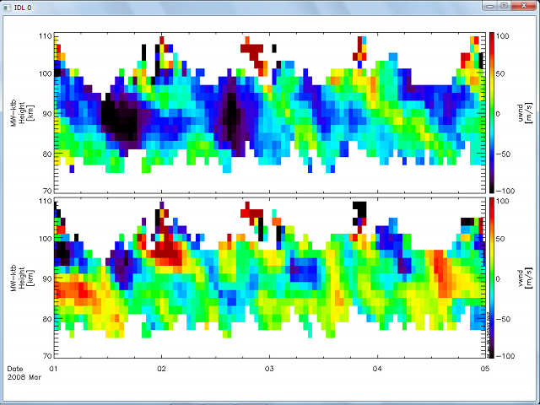
MU radar
Equatorial Atmospheric Radar（EAR）
MF radar
Meteor Wind Radar

Slide 11
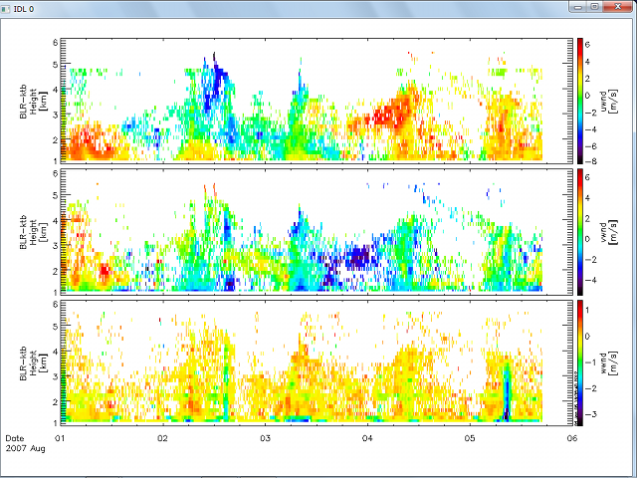
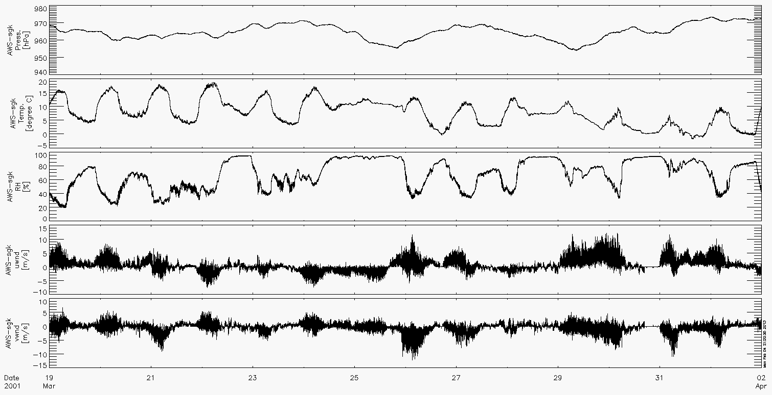
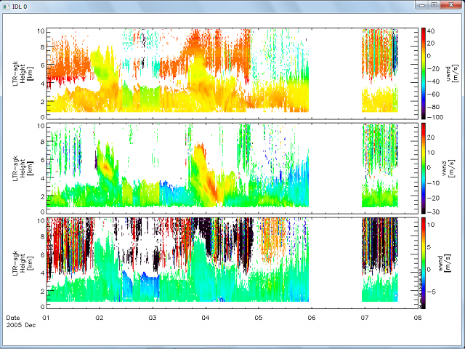
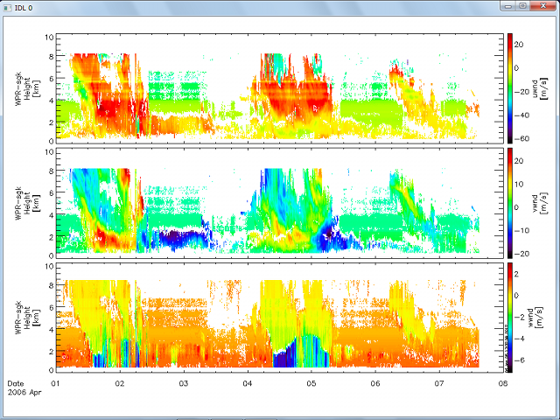
Automatic Weather Station
Boundary Layer Radar
L-band Lower Troposphere Radar
Wind Profiler

Slide 12
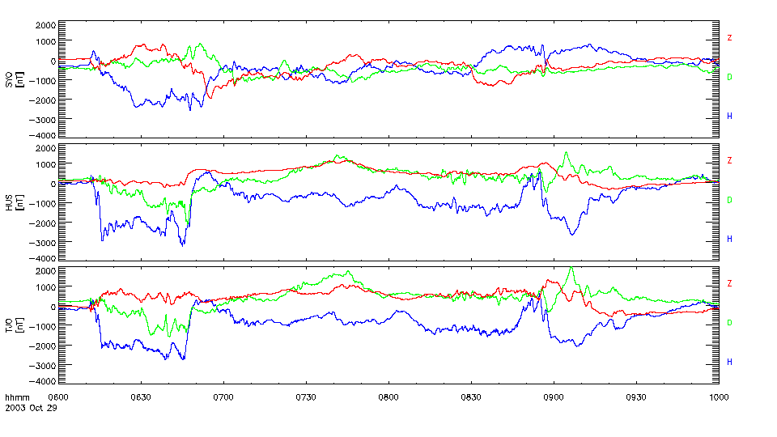
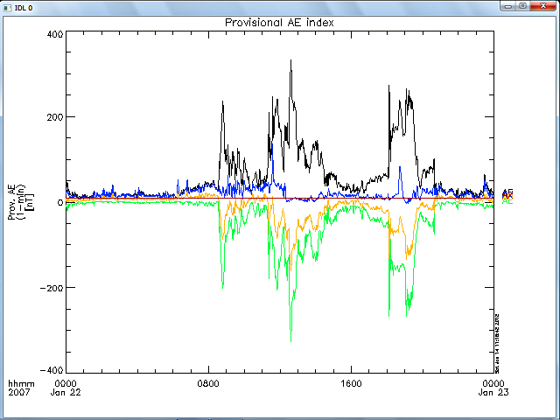
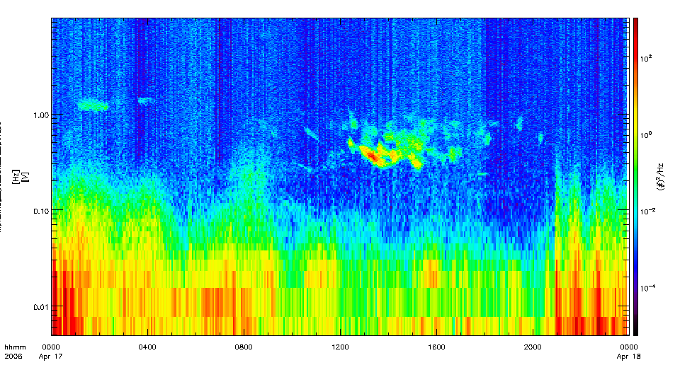
Fluxgate magnetometer
Geomagnetic Indices from WDC
Induction magnetometer

