Slide 1
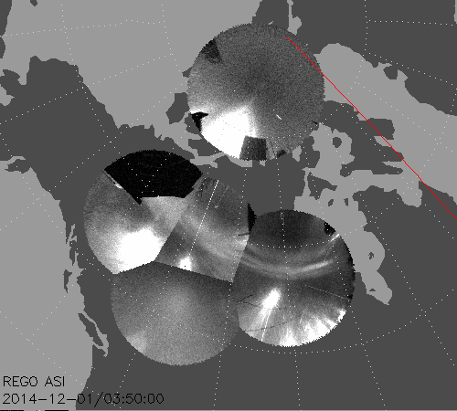
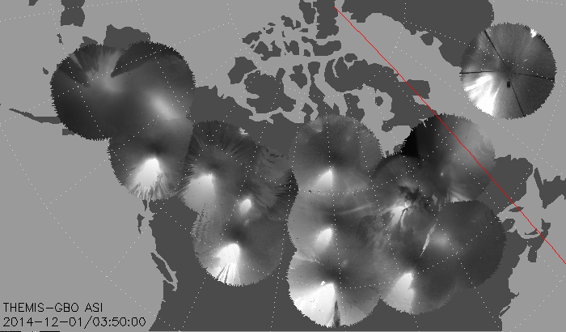
THEMIS/GIMNAST white-light all-sky cameras
UCalgary Redline Emission Geophysical Observatories (REGO)
IDL command:
thm_asi_merge_mosaic,’2014-12-01/03:50:00’
Need to download latest version of SPEDAS with procedures thm_rego_create_mosaic.pro, thm_load_rego.pro, thm_rego_array.pro
Update path to !themis.local_data_dir/thg/l1/reg/
Update file !themis.local_data_dir/thg/l2/asi/cal/thm_map_add.sav
IDL command:
thm_rego_create_mosaic,’2014-12-01/03:50:00’

