Slide 1
TDAS – v9.00
GEM – Snowmass, Co
June 2015

Slide 2
What's new in TDAS
TDAS version 9.0 released.
SST L2 CDF(with moments!) released.
ESA L2 Data quality flags available.
Combined particle moments + spectrograms tool released.
In public testing.
FGM L2 Data quality flags under testing for release.
New GMAGS:
STEP network.
Penguin pg1-pg4
Project directories reorganized for SPEDAS integration.
ERG, Iugonet, Akebono project github build integration to streamline plugin updates.
Many new GUI features.(Covered in SPEDAS presentation)

Slide 3
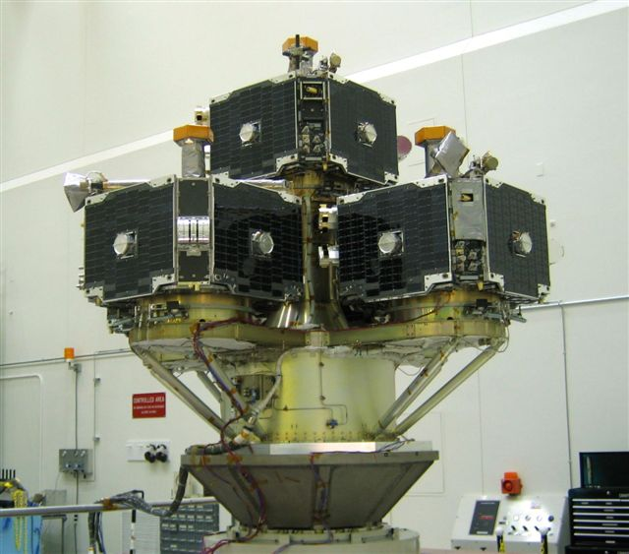
Acknowledgements
THEMIS Data Analysis Software
Organization Contributors
UC Berkeley D Larson, H Frey, J Bonnell, J McFadden, A Keiling
J McTiernan, B Sadeghi, N Hatzigeorgiu, J Lewis
UCLA V Angelopoulos, P Cruce, C Russell, H Leinweber,
A Flores, K Ramer, B Kerr, M Feuerstein, L Philpott,
E Grimes
SP Systems K Bromund
APL H Korth
NASA/GSFC V Kondratovich
MPE E Georgescu
TUBS U Auster
CETP P Robert, O LeContel
Calgary B Jackel, E Donovan
Notes:
3

Slide 4
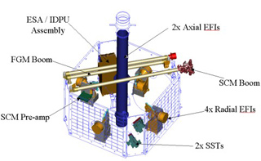
Space Based Instruments
FIELDS INSTRUMENTS:
EFI - Electric Field Instruments FGM - Flux Gate Magnetometer
SCM - Search Coil Magnetometers
PARTICLE INSTRUMENTS:
ESA - Electrostatic Analyzer SST - Solid State Telescope

Slide 5
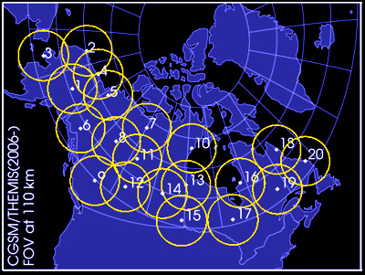
Ground Based/Processed Data
GROUND BASED:
ASI – All-Sky Imager Array GMAG – Magnetometer Array
PROCESSED DATA:
FBK – Filter Bank FIT – Onboard Spin-Fit
FFT – Fast Fourier Transform
MOM – Onboard Moments
STATE – Spacecraft state vectors

Slide 6
Data Definitions
The software operates on Level 1 and Level 2 data.
Data Level Definitions:
Level 0 Data –
Raw files (*.pkt) one per APID.
Only used for loading ESA data.
Level 1 Data -
CDF (Common Data Files) files (*.cdf)
Files contain raw, un-calibrated data. i.e. counts, DAC units.
Requires TDAS software to interpret. Calibration is done by default when Level 1 data is input.
Level 2 Data -
CDF files – contain physical quantities – TDAS software is not needed for interpretation.
Files available for ESA, FBK, FIT, FFT, FGM, MOM, SST, EFI – can be downloaded from SPDF.

Slide 7
Status Report
V9.00 Science Software/Data Status Report
STATE L1 STATE available since launch, V03 STATE (improved attitude and spin phase corrections)
FGM L1, L2 data available since early March 2007
FIT / FFT / FBK - L1, L2 data available since early March 2007
SCM L1 data available since early March 2007
L2 frequency spectrograms (FBK) available now
L2 SCM available since May 2010
EFI All L1 data available from TH-C since May 2007, TH-D,E since Jun 7
L2 EFI available
ESA No L1 data, only L0 data – however, read-in is transparent to user
All data available since ESA turn-on, i.e., mid-March
L2 omnidirectional energy spectrograms, ground moments available now.
MOM On-board moments available from August 2007 on. L2 moments (from ESA only) available.
SST L1 data available since SST turn-on, mid-March
L2 omnidirectional energy spectrograms and moments available now.
ASI L1 thumbnail images from 21 stations available.
L1 full-resolution images available
Mosaics, movies for full mission
GMAG L2 CDF files with ground magnetometer data from 137 stations
Other Missions
GOES – All high-resolution (0.5s), 1-m, 5-m magnetometer/particle data from GOES 08-15 satellites
FAST – HR DCB data, available from 09/1996 – 10/1998
ACE - The ACE data consists of magnetometer values in GSM coordinates with one minute averages
and Solar Wind Electron Proton Alpha Monitor data
Geomagnetic indices:
Ap, Cp, C9, Kp, Dst, Sym/Asy, AE, PseudoAE (AE from THEMIS ground mag stations)

Slide 8
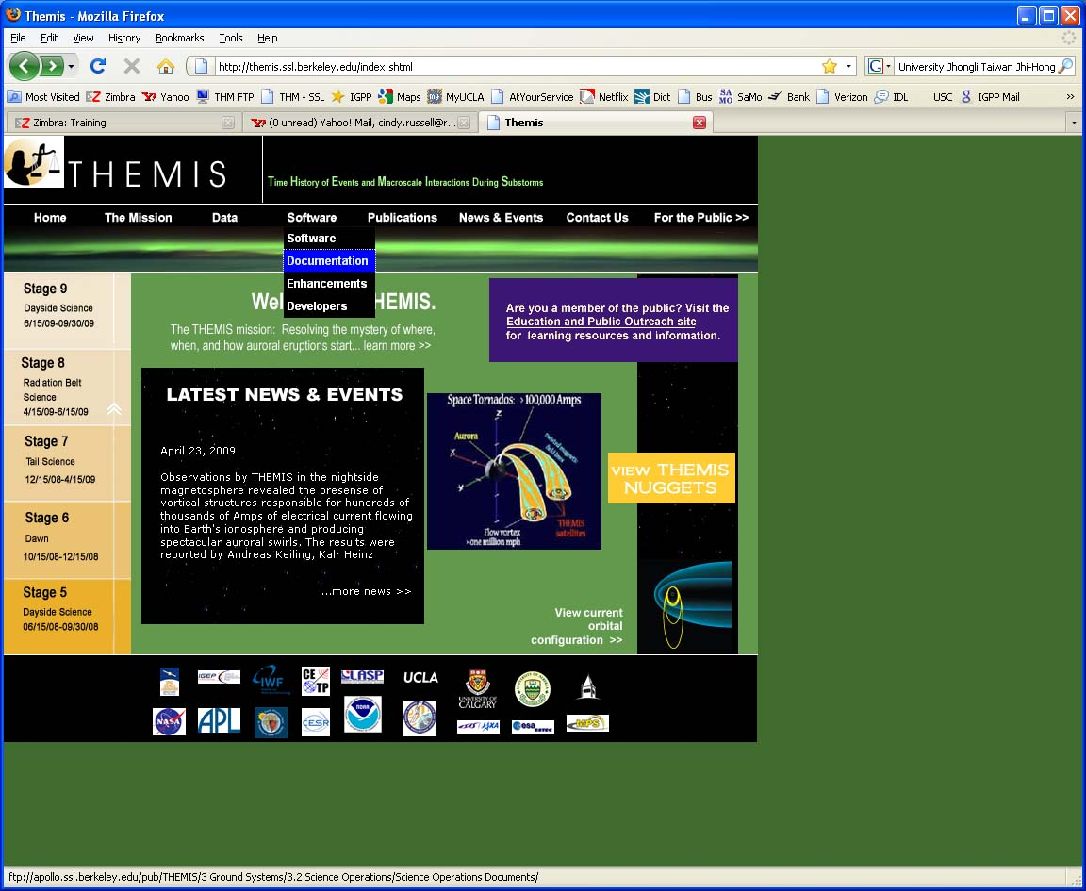
THEMIS Main Web Page
http://themis.ssl.berkeley.edu

Slide 9
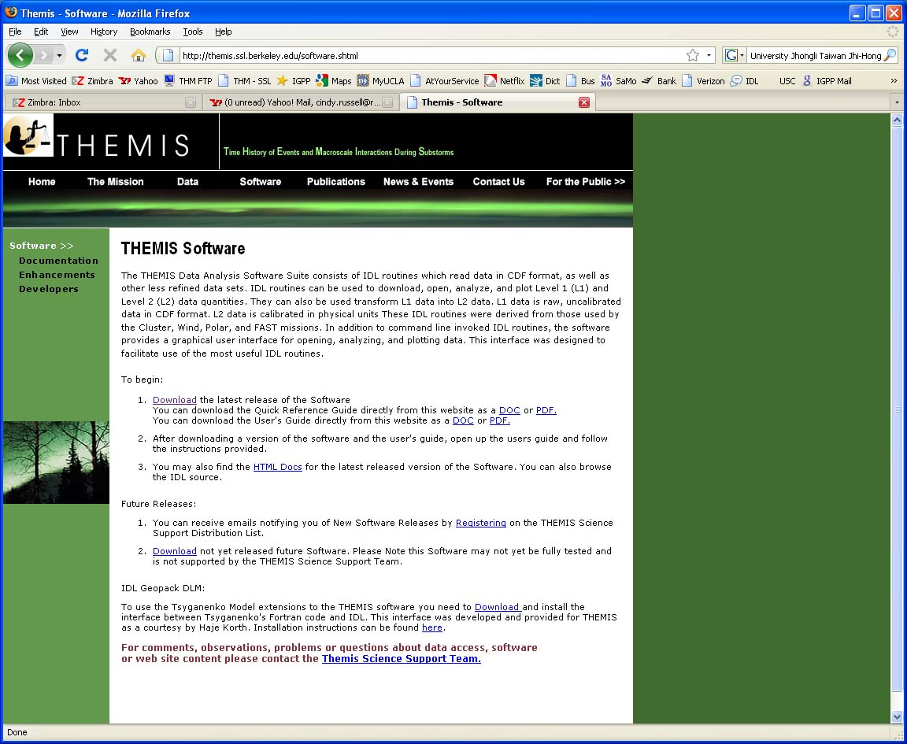
THEMIS Software Web Page
THEMIS_Science_Support@ssl.berkeley.edu

Slide 10
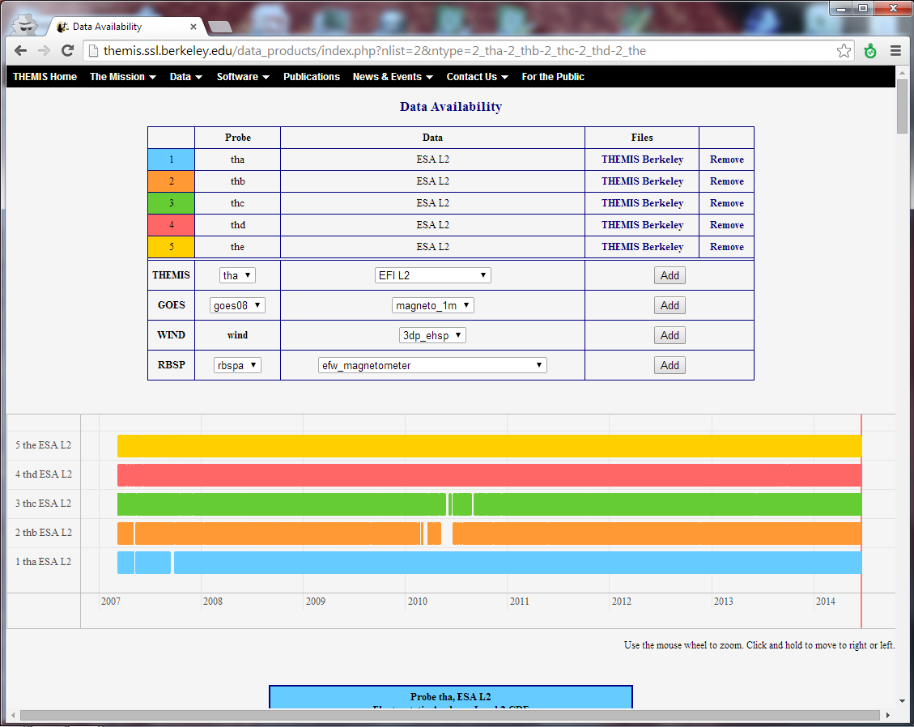
Data Availability Page
Select:
‘Data Availability’ from the ‘Data’ menu on our main page, themis.ssl.berkeley.edu/

Slide 11
Software Objectives
THEMIS Data Analysis Software (TDAS) Objectives
Powerful, flexible command line interface
GUI provides easy access to data, analysis tools, and graphics
IDL based (library of routines – but no main program!)
Code is available to everyone
It is not required to analyze level 2 data
Easily tailored for other missions
Functionally separates the tasks into:
Reading/importing
Manipulating
Plotting
Platform independent. Works on:
Linux
Windows XP, Vista, 7
Mac OS X
Solaris

Slide 12
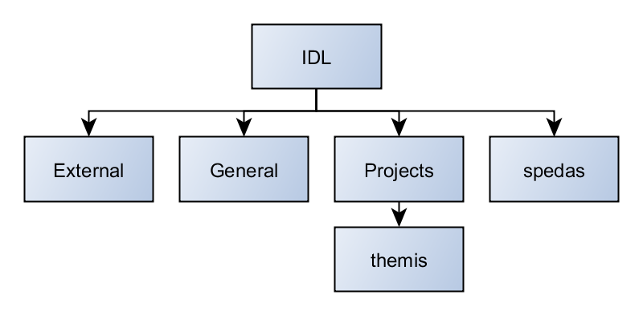
Software Organization
Projects
Directory for all SPEDAS projects
themis
Routines specific to THEMIS
Organized by instrument
Load and calibrate data, coordinate transformations, analysis routines
general
Library of generic routines useful for building mission-specific load routines
Plotting (tplot), data processing, and data import/export routines
external
CDAWlib – from NASA SPDF, reads/plots CDF data
IDL_GEOPACK – IDL magnetic field modeling library

Slide 13
System Requirements
Windows, Solaris, Linux, Mac OS X
IDL 6.4 or higher required
IDL CDF Patch Recommended
Required for IDL 6.2, (Strongly recommended for IDL 6.4 and up)
http://cdf.gsfc.nasa.gov/html/cdf_patch_for_idl.html
For Mac, system configurations are required to run IDL
Recommend IDL 8.2.3 for Mac users.
Detailed installation instructions can be found in the ‘quick start’ guide on the THEMIS and SPEDAS websites
See THEMIS User's Guide for full information, available at:
ftp://apollo.ssl.berkeley.edu/pub/THEMIS/

Slide 14
Installing/Configuring TDAS
Installation
Download and expand the latest TDAS release .zip file. The latest version is 9.00 http://themis.ssl.berkeley.edu/socware/tdas_9_00/tdas_9_00.zip
Set up the IDL path
File->Preferences
Then IDL->Paths
Select “insert”
Select the location of downloaded TDAS
Use arrows to move directory above <IDL_DEFAULT>
Set path to Data Directory
Data directory will be created automatically at
C:/data/themis (Windows)
~/data/themis (UNIX/Linux/Max OS X)
Run thm_ui_config from command line or THEMIS GUI if you need to change this.

Slide 15
Data / Directory Structure
Data Directory structure is large!
~3GB/day for all probes (L1 data)
Directory hierarchy keeps directory size manageable
Software performs automatic file retrieval.
Software enforces directory hierarchy.
Behaviour of Automatic File Retrieval is configurable
‘No Download’ mode for stand-alone operation.
‘No Update’ mode to preserve local modifications.
Root directory determined automatically, is configurable.
Available configuration methods:
thm_ui_config IDL widget
In THEMS GUI, ‘File’ -> ‘Configuration Settings...’
Environment variables

Slide 16
Primary Routines
Usage Conventions:
Use IDL keywords to determine functionality
Data Levels - Calibrated Level 1 data is the default (Except for SST and ESA data, which are handled differently).
Data type and Probe keywords determine which data is loaded and/or created through the calibration process
Get_Support_Data keyword needed in thm_load_state to load data needed by thm_cal* and thm_cotrans routines
To load uncalibrated data, set type = ‘raw’ (For all but SST, ESA)
IDL Command Line Examples:
timespan,’2007-07-07’, 1, /days ;choose a time range
thm_load_state, probe = 'a', /get_support_data
thm_load_fgm, probe='a', coord='gsm', datatype='fgl', level=1

Slide 17
Variable Names
Probe specification. Example: tha
a – can be one of [a-e] specifies probe
Particle data. Example: tha_peif
p – particles
e – ESA, s – SST
i – ions, e – electrons
f – full, r – reduced, m – moments, b – burst
FGM data. Example: tha_fgl
l – low telemetry rate, h – high telemetry rate, e – engineering decimated high rate, s – spin fit.
Electric Fields and SCM. Example: tha_efs
ef - efi, sc – scm, fb – fbk, ff – fft
s – spin fit, f – full orbit or fast survey, p – particle burst, w – waves burst.
Wildcards are accepted in names when plotting and data processing:
th?_fg?
th[ab]_fg[lh]
th?_state*

Slide 18
Primary Routines
Load Routine Summary
Name | Description | Level 0 | Level 1 |  | Level 2
 |  |  | Raw | Calibrated
thm_load_asi | All-Sky Imager |  | * | (-)
thm_load_ask | All-Sky Keogram |  | * | (-)
thm_load_efi | Electric Fields Instrument Waveforms |  | * | * | *
thm_load_esa | ElectoStatic Analyzer |  |  |  | *
thm_load_esa_pkt | ElectoStatic Analyzer | *
thm_load_fbk | Fields Filter Bank |  | * | * | *
thm_load_fft | On-Board Fields Fast Fourier Transform |  | * | * | *
thm_load_fgm | Flux Gate Magnetometer Waveforms |  | * | * | *
thm_load_fit | On-Board Fields Spin-Fit |  | * | * | *
thm_load_gmag | Ground Magnetometer |  |  |  | *
thm_load_hsk | Housekeeping |  | * | *
thm_load_mom | On-Board Particle Moments |  | * | * | *
thm_load_scm | Search Coil Magnetometer Waveforms |  | * | * | *
thm_load_sst | Solid State Telescope |  | * | (-) | *
thm_load_state | Orbit and Attitude |  | V3
thm_load_pseudoae | THEMIS gmag Derived AE-Index |  |  | *
thm_load_slp | Solar Lunar Position, Attitude, Velocity |  |  |  | *
thm_load_scmode | Spacecraft Mode |  |  | *
thm_load_trg | Spaceraft Trigger |  | *
thm_load_bau | BAU Housekeeping |  | * | *
Notes:
(-) data reduction and analysis routines available: see crib sheet

Slide 19
Crib Sheets
Crib Sheets for Loading, Processing and Plotting
thm_crib_asi
thm_crib_dproc
thm_crib_efi
thm_crib_esa_da
thm_crib_esa_moments
thm_crib_export
thm_crib_fac
thm_crib_fbk
thm_crib_fft
thm_crib_fgm
thm_crib_fit
thm_crib_gmag
thm_crib_mom
thm_crib_mva
thm_crib_overplot
thm_crib_part_getspec
thm_crib_scm
thm_crib_sst
thm_crib_state
thm_crib_tplot
thm_crib_tplotxy
thm_crib_twavpol
thm_crib_part_slice2d
thm_map_examples
thm_crib_part_combine
IDL>.run thm_crib_asi
or cut and paste, or copy and modify

Slide 20
Coordinate Transformations
thm_cotrans
transforms to/from any of the following coordinate systems
updates metadata in output
Currently Supported Geophysical Coordinate Systems
SPG Spinning Probe Geometric
SSL Spinning SunSensor L-vectorZ
DSL Despun SunSensor L-vectorZ
GEI Geocentric Equatorial Inertial
GSE Geocentric Solar Ecliptic
GSM Geocentric Solar Magnetospheric
SM Solar Magnetic
GEO Geographic Coordinate System
SSE Selenocentric Coordinate System
SEL Selenographic Coordinate System
MAG Geomagnetic Coordinate System
Example (previously loaded FGM and STATE data)‏
thm_cotrans, 'th?_fg?', out_coord='geo‘, ouf_suffix = ‘geo’
Notes:
20

Slide 21
Plotting & Analysis Routines
Plotting
tplot
tplotxy
plotxy
plotxyz
tplot_names
tlimit
get_data
store_data‏
Analytic Coordinate Transformations
tvector_rotate
fac_matrix_make
thm_fac_matrix_make
minvar_matrix_make
enp_matrix_make
rxy_matrix_make
sse_matrix_make
gsm2lmn
Tsyganenko Model
(t)trace2iono
(t)trace2equator
(t)t89
(t)t96
(t)t01
(t)t04s
Example:
> tt89,'thc_state_pos',newname='model_field'
> fac_matrix_make,'model_field' ,other_dim= 'xgse',
newname = 'fac_mat'
> tvector_rotate, 'fac_mat', 'thc_peir_velocity',
newname = 'ion_velocity_model_fa'
Notes:
21

Slide 22
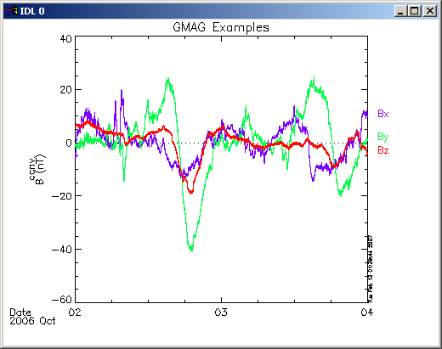
Command Line Example 1
To load data:
> timespan,'6-10-2', 2, /days
> thm_load_gmag,site='ccnv', $
/subtract_average
To plot data:
> options,'thg_mag_ccnv',$ labels=['Bx','By','Bz']
> tplot_options, 'title', $ 'GMAG Examples'
> tplot,’thg_mag_ccnv’

Slide 23
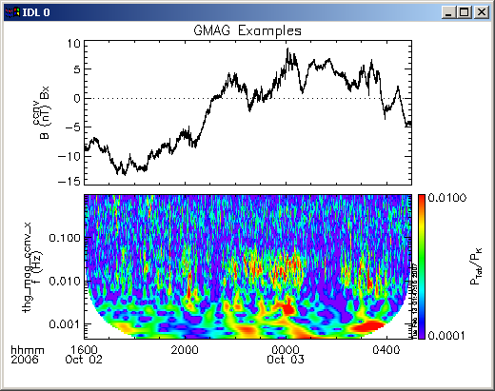
Command Line Example 2
Wavelet transform on an interval of interest
Define and display the interval
> tr = ['2006-10-2/16:00','2006-10-3/05']
> timebar,tr
Split the 3-vector into components:
> split_vec,'thg_mag_ccnv'
Compute transform of one component
> wav_data,'thg_mag_ccnv_x',/kol $ ,trange=tr ,maxpoints=24l*3600*2
Set color limits (log scale)
> zlim,'*pow', .0001,.01,1
Plot it.
> tplot,'*ccnv_x*',trange=tr

Slide 24
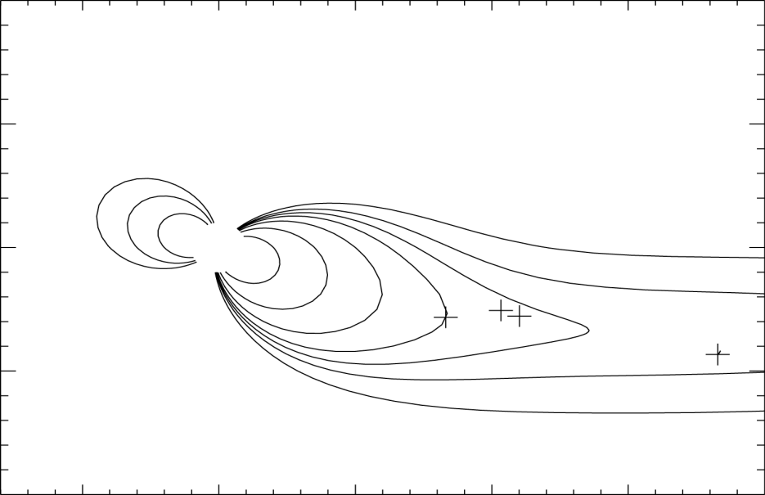
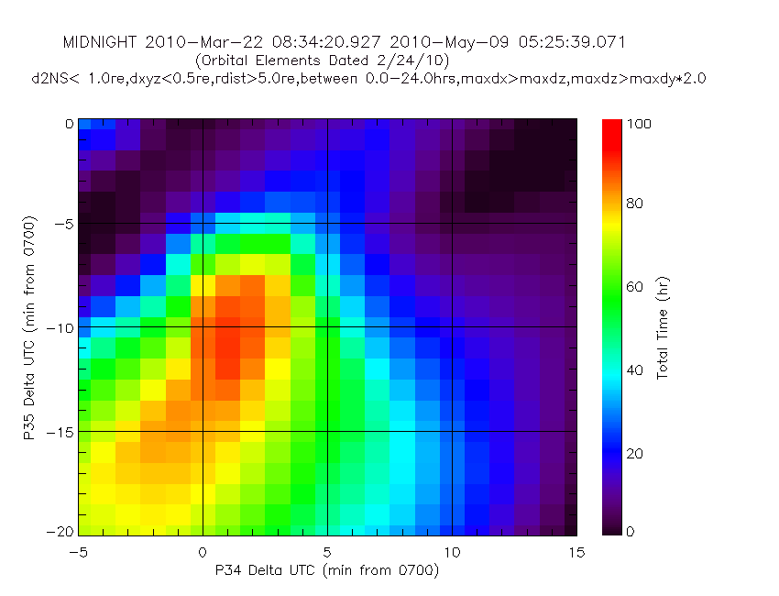
Plotting Examples
tplotxy can be used to plot isotropic position plots - like plots of magnetic field models and spacecraft position
plotxyz can be used to plot 3 dimensional isotropic data, with any axis (not restricted to time-series data)‏
Notes:
24

Slide 25
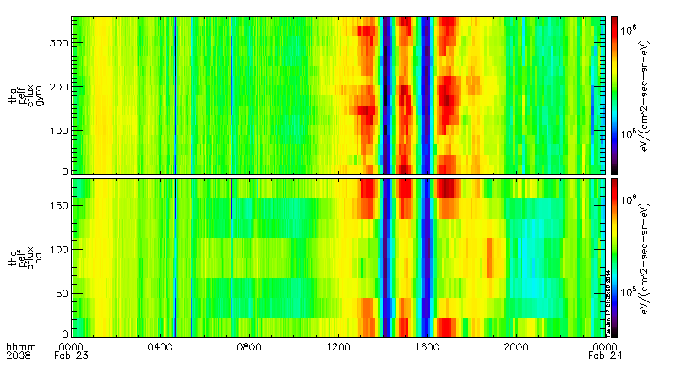
Plotting Angular Spectra
thm_crib_part_products
pitch angle and gyrophase
full
reduced
full
reduced

Slide 26
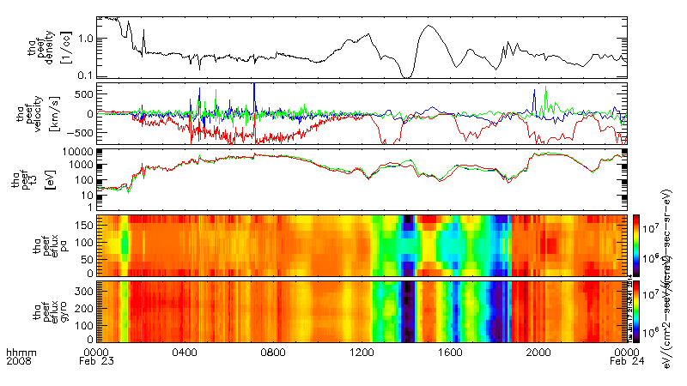
Calculating/Plotting Moments
thm_crib_part_products

Slide 27
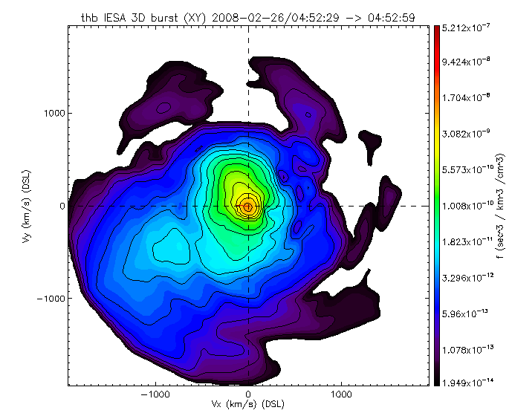
3D Particle Slices
thm_crib_part_slice2d_plot
3D interpolation method
Entire distribution is linearly interpolated in 3 dimensions.

Slide 28
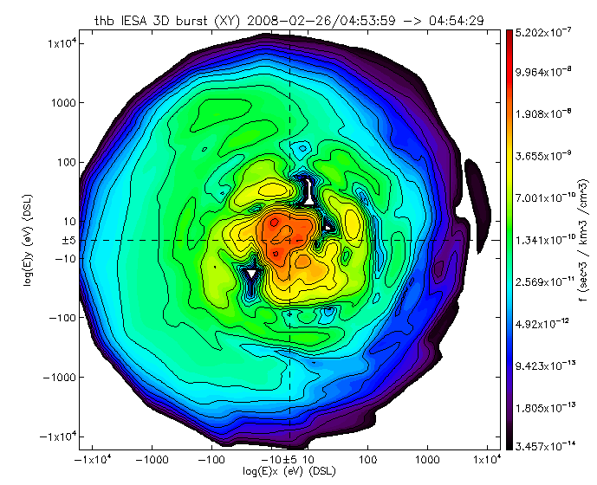
3D Particle Slices
Use /ENERGY keyword
to plot against energy!

Slide 29
Trace / Orbit Plots
Trace / Orbit Plots
New routines have been added to perform different 2d projections of 3d data.
This particularly useful for plotting orbits and field lines.
A Tsyganenko interface has been added to TDAS that allows us to calculate model field lines for T89,T96,T01,&T04 models. Field lines can also be traced (now available in the GUI!)
Examples of these routines can be found in thm_crib_trace.pro
thm_crib_plotxy.pro
thm_crib_tplotxy
The graphics in the next slide were generated with thm_crib_trace.pro
Example: .run thm_crib_trace.pro
A routine was added to plot an arbitrarily sized and spaced AACGM
coordinate grid on a world map.
NEW (05/16/2014): IDL GEOPACK v9.3 released and includes an interface to Geopack 2008: http://ampere.jhuapl.edu/code/idl_geopack.html
reduced

Slide 30
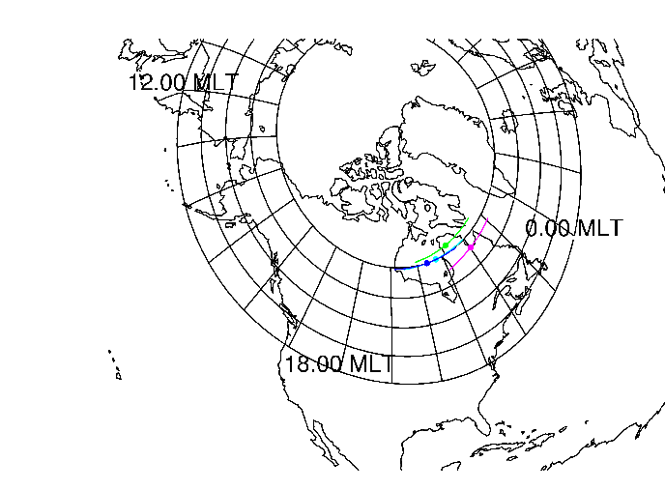
Trace / Orbit Plots
Trace/Orbit Plots - AACGM/Ionosphere Trace Plot
reduced

Slide 31
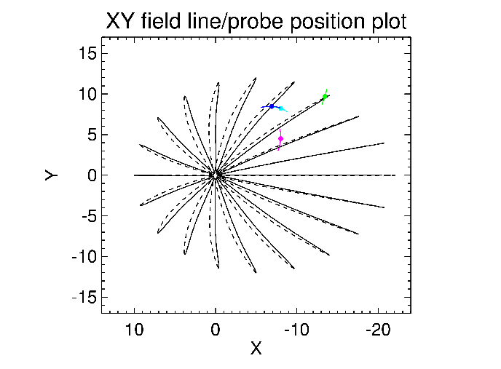
Trace / Orbit Plots
Trace / Orbit Plots – XY Plot
reduced

Slide 32
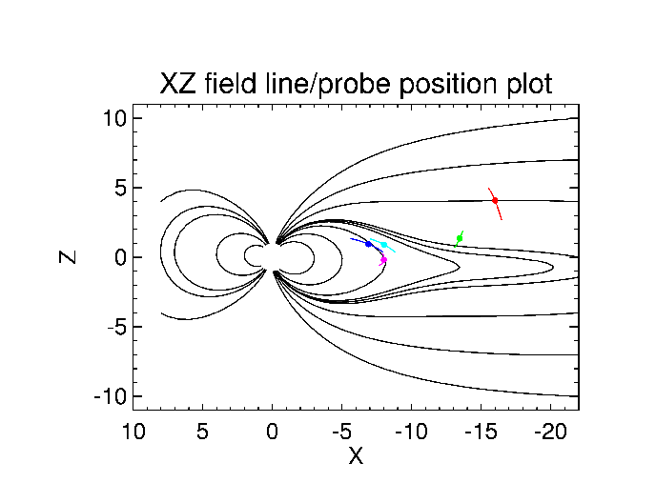
Trace / Orbit Plots
Trace / Orbit Plots – XZ Plot
reduced

Slide 33
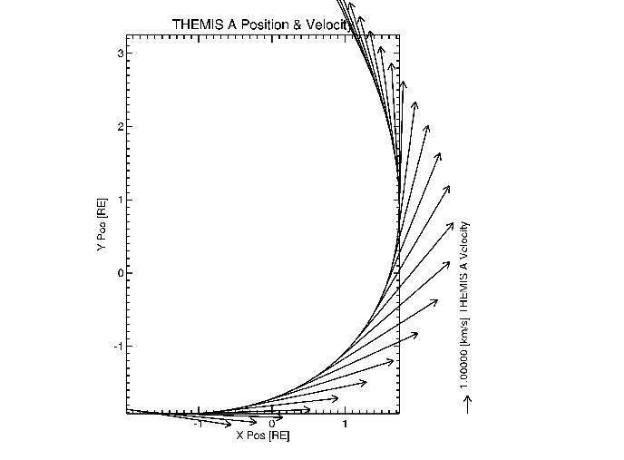
Trace / Orbit Plots
Position/Velocity vector plot - plotxyvec
reduced

Slide 34
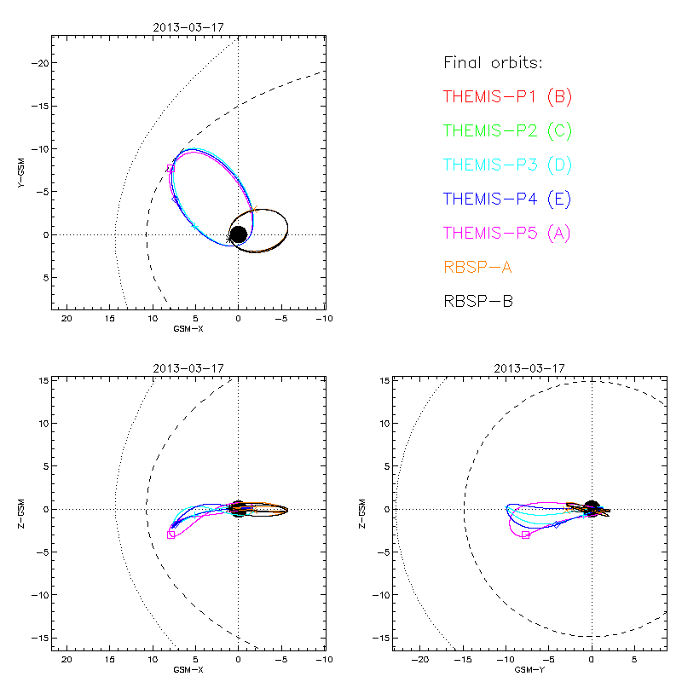
Best Place to Get Orbit Plots?
THEMIS website!
Quick and linkable, i.e., you can now copy + paste the URL to summary plots you generate on the web

Slide 35
Mini Language
THEMIS – Mini Language
Simple scripting language has been written in IDL.
This language allows access to some data analysis functionality in the IDL
virtual machine and eases manipulations of time series (tplot) data
This language allows composition of statements and functions with order of operations to give significant flexibility in statement construction
Examples:
1: Position to RE:
calc,'"tha_pos_re" = "tha_state_pos"/6374.4’
2: Natural log of total esa density:
calc,'"tha_density_log" = ln("tha_peir_density"+"tha_peer_density“)
3: Store tplot data in non-tplot idl variable: calc,'var_data = "tha_efs“’
4: Average magnetic pressure:
calc,'Pb_avg = mean(0.01*total("tha_fgs_dsl"^2,2)/25.132741)‘
Additional examples can be found in themis/examples/thm_crib_calc.pro
reduced

Slide 36
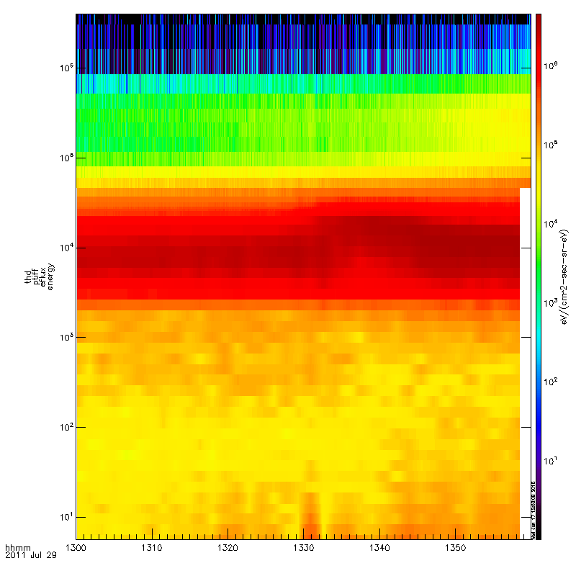
Combined Particle Moments
To load data:
probe = ‘d’
trange = ‘2011-07-29/’ + [’13’,’14’]
combined = thm_part_combine($
probe=probe,trange=trange,$
esa_datatype=‘peif’,sst_datatype=$
‘psif’)
To plot data:
> thm_part_products,dist_array=combined,$
outputs=‘energy’
> tplot,’thd_ptiff_eflux_energy’

Slide 37
THEMIS Data Analysis Software
Graphical User Interface

Slide 38
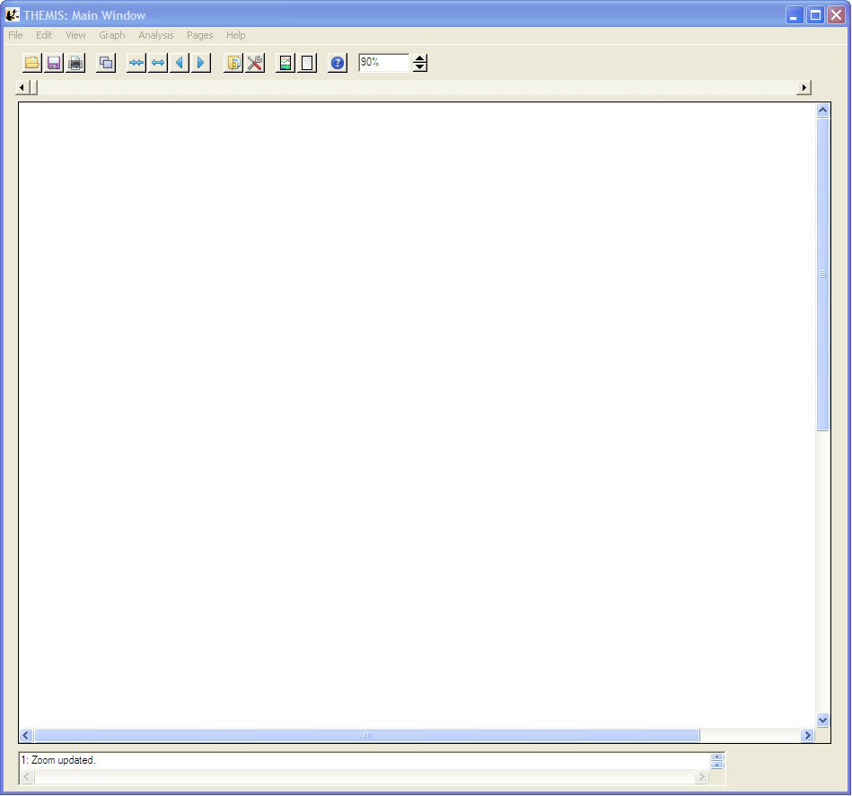
Graphical User Interface
The GUI is the quickest and easiest way to learn TDAS functionality
To run the GUI, type: idl> thm_gui
Menu Bar
Window Resize
Tool Bar
Main graph
area
Status Bar

Slide 39
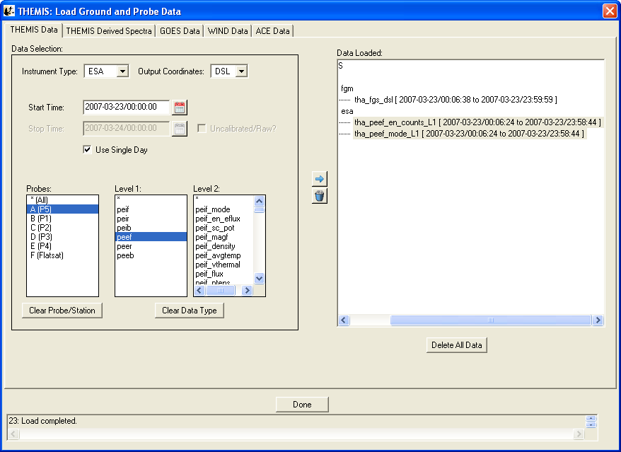
Loading Data – GUI
To Load Data:
Select Load Data under the File menu
Select Instrument Type: fgm, Level2: fgs_dsl, Click Right arrow button
Select Instrument Type: esa, Level1: peef, Click Right arrow button

Slide 40
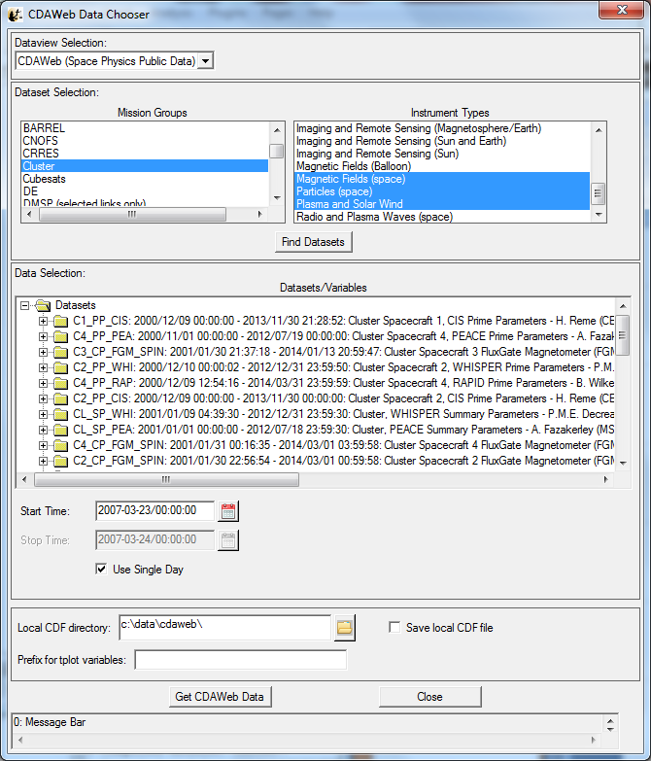
To Load CDAWeb Data:
- Select ‘Load Data using CDAWeb’ under the File menu
- Select Mission Group (i.e., TWINS, Cluster, etc.)
- Select the Instrument Type
- Click ‘Find Datasets’
Select variable or dataset to download
Click ‘Get CDAWeb Data’

Slide 41
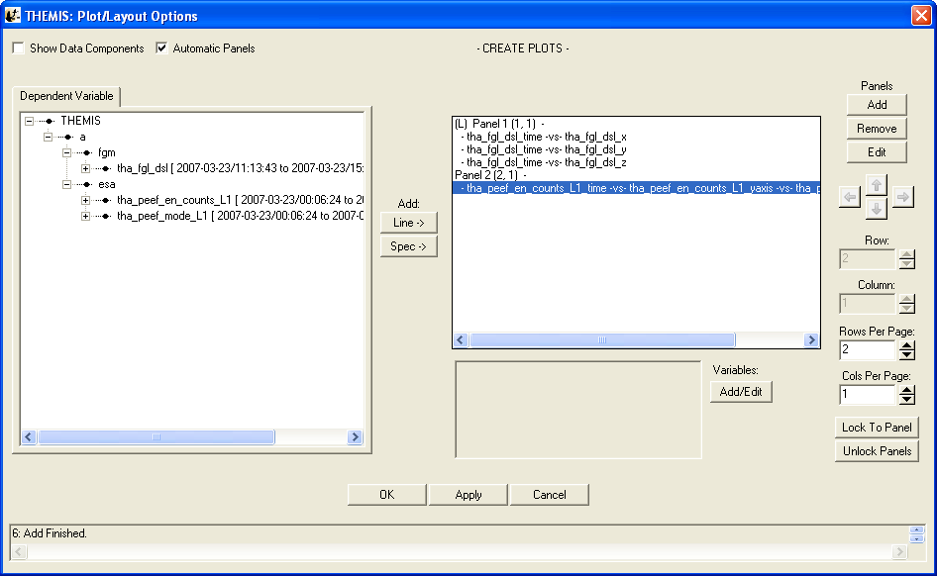
Plotting Data - GUI
To Plot Data:
Select Plot/Layout Options… under the Graph menu
Select tha_fgl_dsl, Click Line button
Click Panels Add button, Select tha_fgl_dsl
Click Panels Add button, Select tha_peef_en_counts_L1

Slide 42
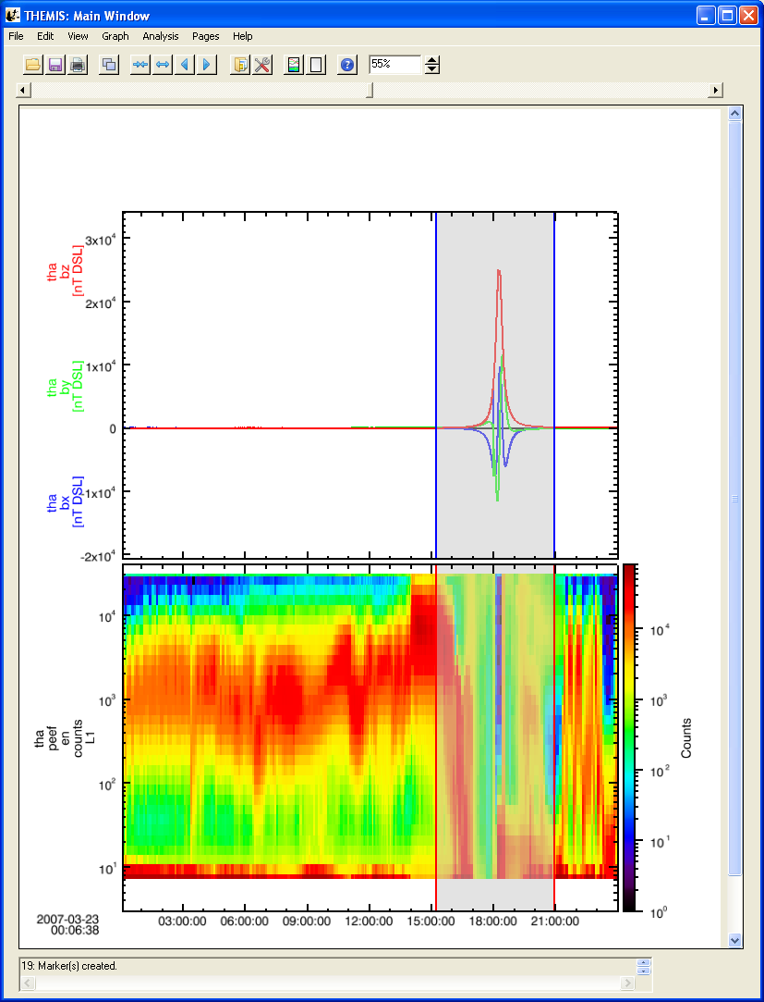
Plotting Data - GUI
Example Plot – FGM and ESA Data
With a few clicks of the
button the user can load,
analyze, and plot data.
THEMIS Science Software Training Software − 42 , 2012

Slide 43
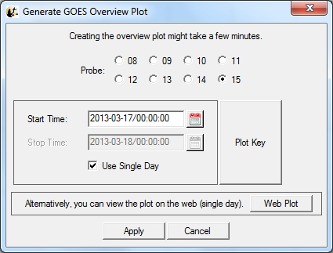
Plotting GOES Overviews
Plugins menu -> ‘Generate GOES Overview Plot

Slide 44
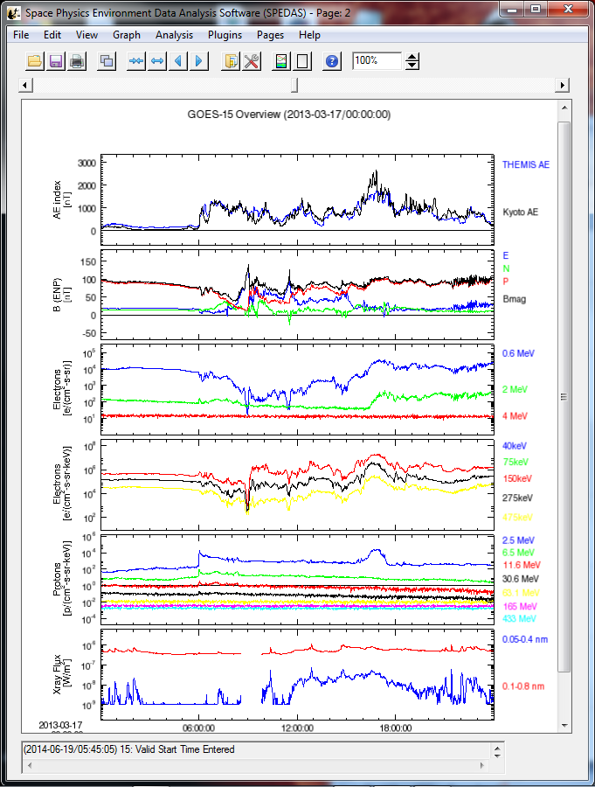
Plotting GOES Overviews

Slide 45
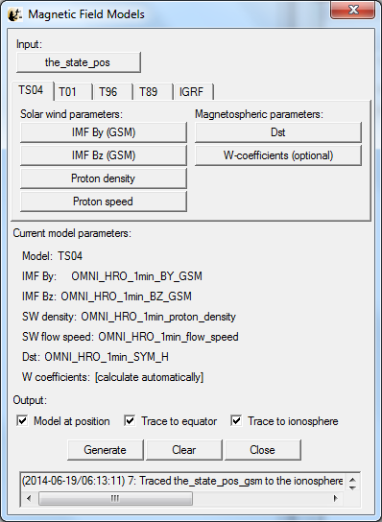
Magnetic Field Models
The GUI is now able to:
- Model the field at the S/C position
Trace the field from the position to the
ionosphere and equator

Slide 46
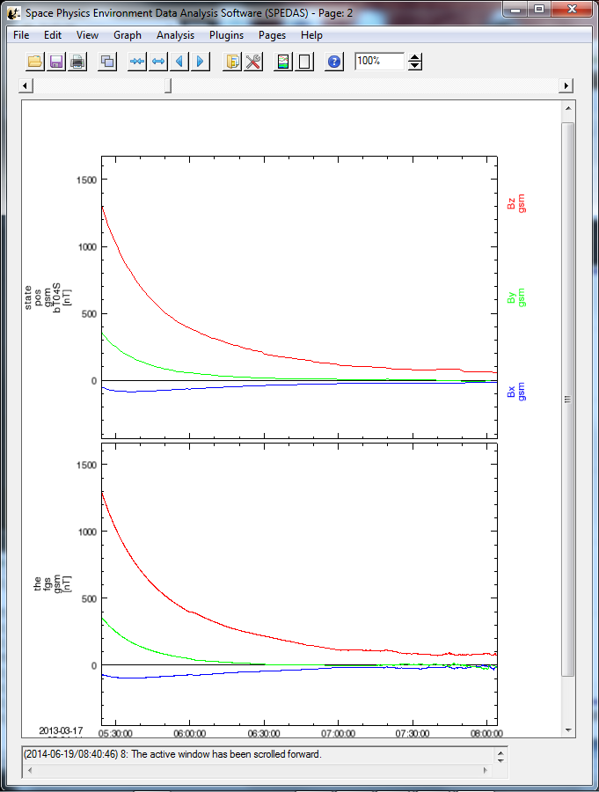
Magnetic Field Models

Slide 47
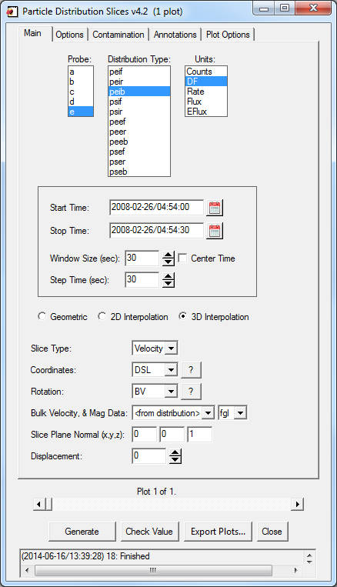
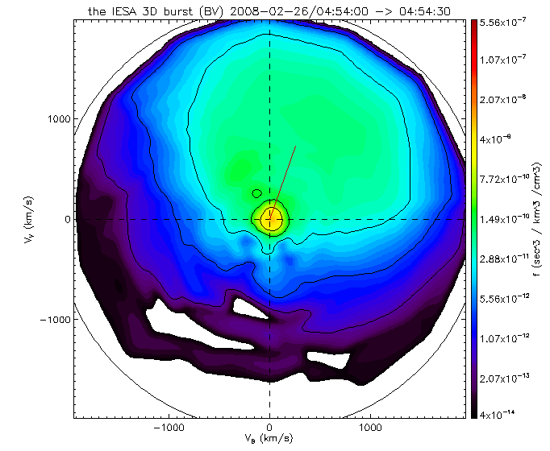
Particle Velocity Slices
Slices of 3d particle velocity distributions
To start: 1) Command line: thm_ui_slice2d
2) GUI: Analysis->Velocity Slices

Slide 48
Backup slides
THEMIS software for GBO all-sky imager
thm_crib_asi.pro
Harald U. Frey
(updated November 2011)

Slide 49
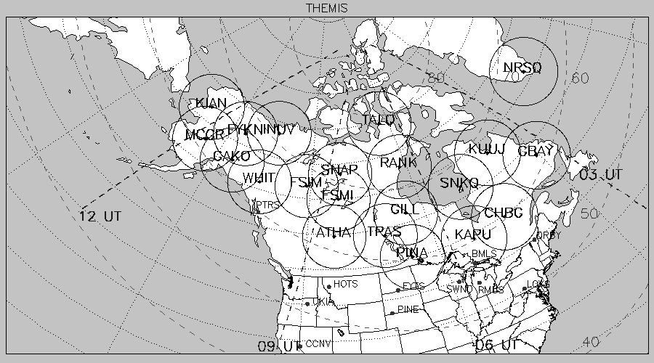
THEMIS GBO network

Slide 50
All-sky imager data products
Keograms along local magnetic meridian
Delivered daily jpeg-compressed
Reprocessed ½ year later with full resolution images
Geomagnetically mapped thumbnail images
Delivered daily using square-root intensity compression
1024 pixels within +-80 magnetic latitude and ~+-120 longitude
3 seconds temporal resolution
Full resolution images
256x256 pixels covering about 600 km radius around station
Delivered about ½ year later
3 seconds temporal resolution
Full 16 bit intensity scale

Slide 51
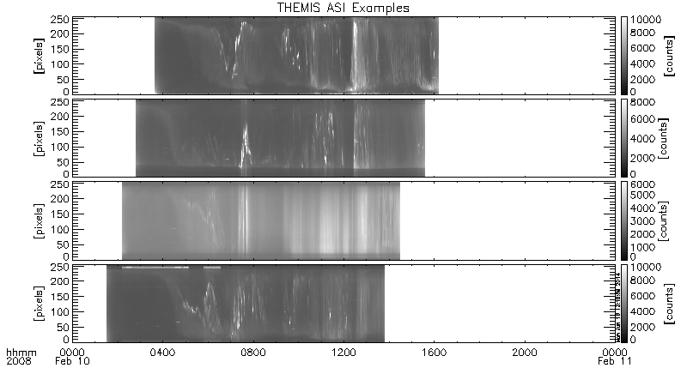
Daily overview of selected keograms

Slide 52
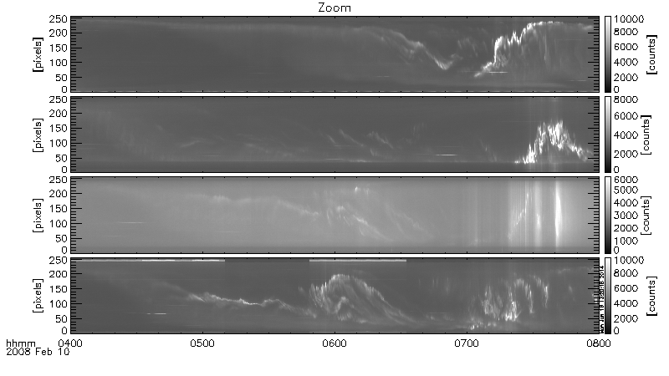
Zoom into interesting time

Slide 53
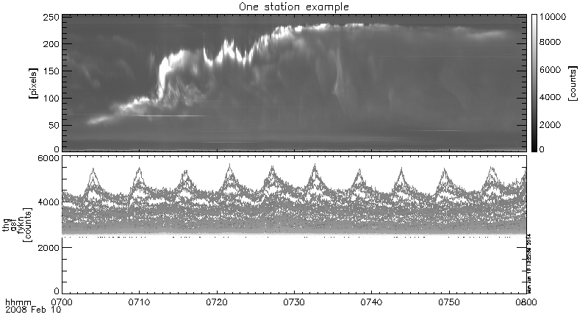
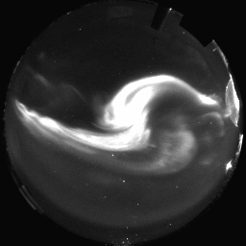
Watch “movie” of single station

Slide 54
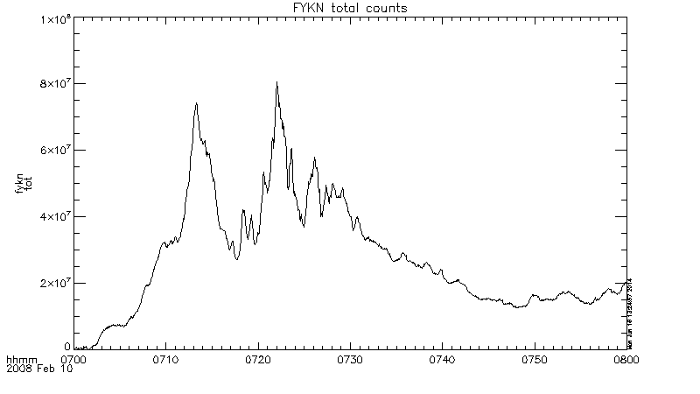
Total number of counts in images to see major increase (substorm onset)

Slide 55
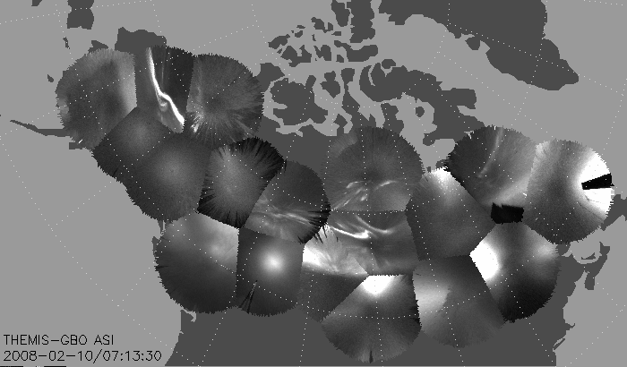
Mosaic of whole GBO array from full resolution images

Slide 56
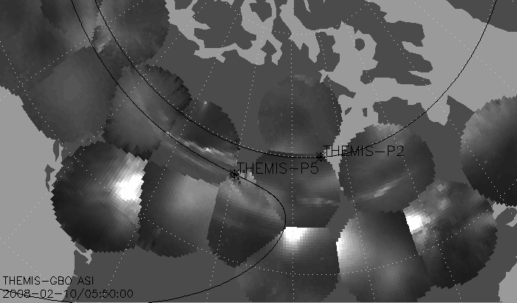
Mosaic with S/C footprint
from thumbnail images
Black line marks footprint of THEMIS-P2 and P5 during whole night
Asterisk marks location at time of mosaic

Slide 57
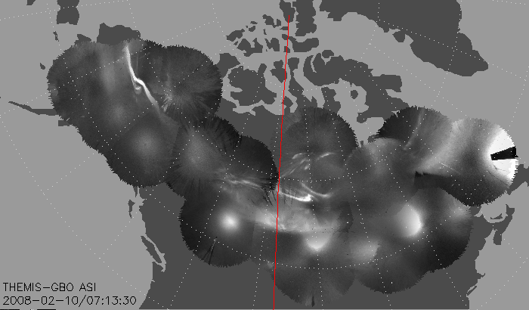
Mosaic of whole GBO array with merged full resolution images
Compare merged mosaic to normal mosaic below
There may still be remaining issues with transitions
Depending on computer it may take up to 5 minutes to finish one merged mosaic
Selecting fewer stations speeds up calculation and may remove sharp borders
!!!!!!!! THIS SOFTWARE IS STILL NOT PERFECT!!!!!!!!!

Slide 58
Ground Magnetometer Examples
thm_crib_gmag.pro

Slide 59
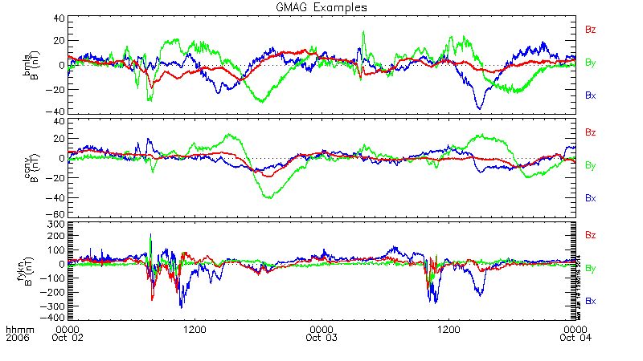
Three Station Example
GMAG Data With Average Subtracted

Slide 60
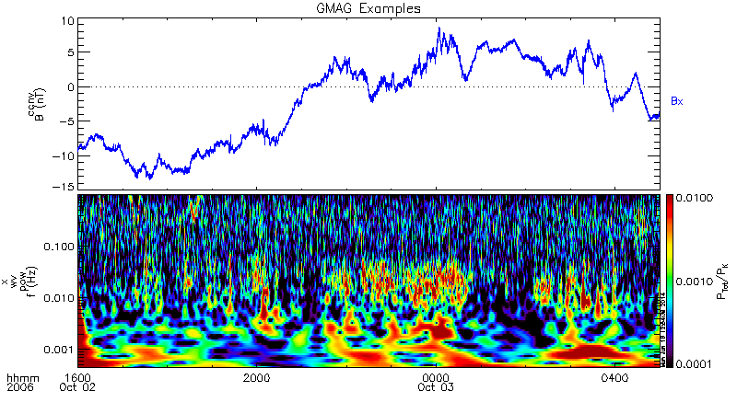
Wavelet Transform Example

